Slide 1
SSCI 586 Final Project
Weather Underground Data Integration
Charles Hall
Fall 2014

Slide 2
Problem and App Scenario
Problem: Obtain weather almanac data for a subset of cities in a feature class
App Scenario: Retrieve almanac data from the weather underground database via their REST api
This is potentially useful in several scenarios:
People unfamiliar with a given city
People searching for cities with a given climate
The app is a python script that is located in a toolbox and called by an add-in

Slide 3
Flow Chart
Script checks feature class for existence of fields and creates if necessary
Cursor iterates over data set and retrieves data via wunderground API
User click on the tool button
User is prompted for a feature class and country
Data is written to fields in attribute table in the input feature class

Slide 4
Development Process
Use httplib to retrieve wunderground data from REST API
Use a cursor to read the feature class
Run and debug in pyscripter
Clean up city names to improve REST retrieval success
Format, alternate name
Create update cursor and iterate over cities
Confirm update in ArcMap
Basic error checking
Ensure that script does not fail when no data is received
Make the feature class and country a parameter
Run and test in ArcMap
Create add-in and test
Final deliverable

Slide 5
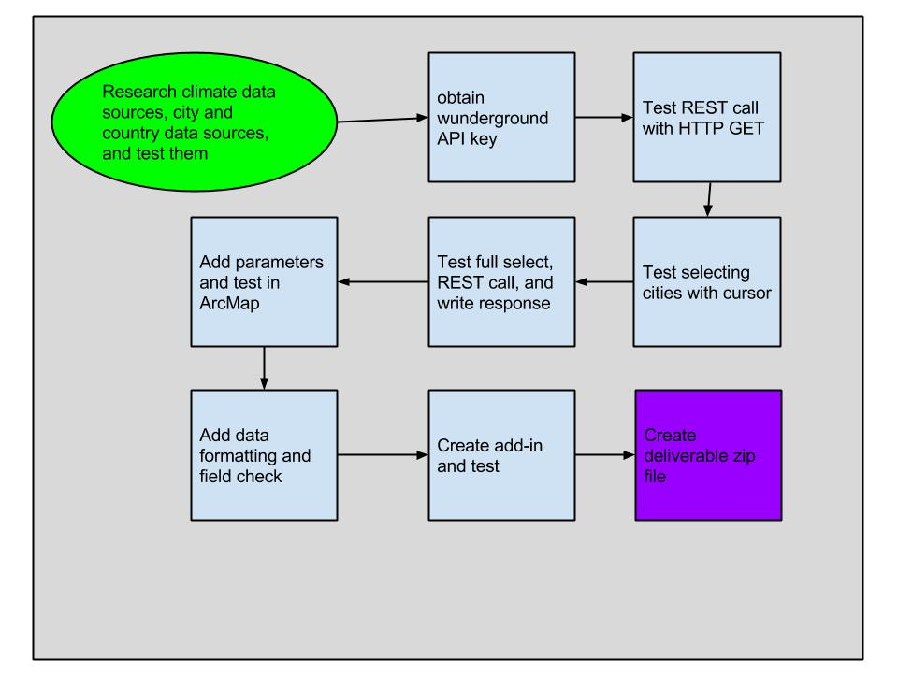
Development Process

Slide 6
Key area: Checking for fields
Checking for the existence of low and high temp fields
fields = arcpy.ListFields(fc, "lowTemp") if len(fields) > 0: print "lowTemp exists" else: arcpy.AddField_management(fc, "lowTemp", "TEXT", "", "", 50) print "No low temp Field" arcpy.AddMessage("Low Temp Field Added")
If the check is not made, the update cursor will fail and crash the program when the fields do not exist

Slide 7
Key Area: Processing data
URL Encode spaces
encselectCountry = selectCountry.replace(" ", "%20")
Create a cursor
cursor = arcpy.da.UpdateCursor(fc, ["CITY", "City_Alter", "Country", "lowTemp", "highTemp"], delimfield +" = '" + selectCountry + "'")
Clean up the data from the feature class
#Replace all spaces with underscores, remove commas city = city.replace(" ", "_") city = city.replace(",", "") #Break multiple cities on one line separated by - into individual cities cities = city.split('-')

Slide 8
Calling the REST Service
HTTPLIB is used to retrieve data from the rest service
JSON format is requested
JSON is parsed and checked for key values
If values are present the attribute table is updated with the data
Otherwise “unavailable” is put in the attribute table

Slide 9
for workCity in cities: # Print working city name for debug purposes #print 'Working city:', workCity arcpy.AddMessage("Working city name: " + workCity) conn.request("GET", "/api/613393ec1cc60128/almanac/q/" + encselectCountry + "/" + workCity + ".json") r1 = conn.getresponse() if r1.status == 200: data1 = r1.read() #print data1 parsed_json = json.loads(data1) if 'temp_low' not in data1: #raise ValueError("No almanac data received") row[3] = "Unavailable" row[4] = "Unavailable" cursor.updateRow(row) else: tempLow = parsed_json['almanac']['temp_low']['normal']['F'] tempHigh = parsed_json['almanac']['temp_high']['normal']['F'] #print tempLow + " " + tempHigh #print r1.status, r1.reason print "The city of %s has a normal low of %s degrees F and a normal high of %s degrees F" % (workCity, tempLow, tempHigh) arcpy.AddMessage("Temp data added for: " + workCity) row[3] = tempLow row[4] = tempHigh cursor.updateRow(row) else: print "Error retireving wg data" del workCity del row del cursor arcpy.AddMessage("Tool completed") print arcpy.GetMessages

Slide 10
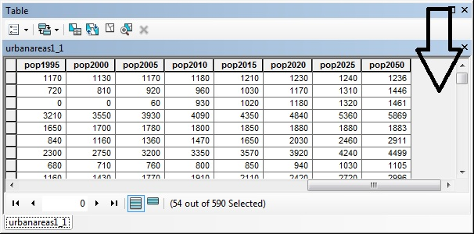
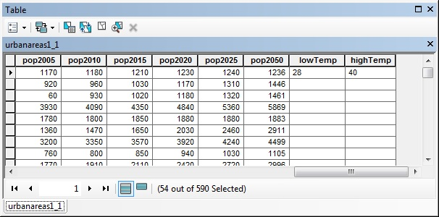
The attribute table

Slide 11
The add-in
Is a simple function call to my script in a toolbox
This makes the add-in code very simple
This also makes the entire system more complicated
The add-in and toolbox must be present in order for the system to work
pythonaddins.GPToolDialog(r'G:\586\final\Final.tbx', 'Wunderground')

Slide 12
Problems Encountered
The low number of calls available via the free API key at weather underground. I worked around this by using Bulgaria as my country, there is only 1 city in the feature class.
Your wunderground API key (613393ec1cc60128) exceeded its allotted usage today by making 85 calls within a minute but the limit is 10. We used one of your raindrops instead of disabling the key for the remainder of the day. You now have 8 remaining raindrops. We check usage for 24-hour periods based on U.S. Eastern Time.

Slide 13
Problems Cont.
Parsing and using XML data, things were easier once I switched to JSON.
Built in JSON parser made accessing the data much easier
I discovered a pretty print library that I intend to investigate
Checking for the existence of the fields was harder than I expected.
The code in the book did not work. fields.Next() produced an error
Determining the proper format for the where clause in the update cursor.
Again several different examples that were inconsistent

Slide 14
Problems cont.
Creating the add-in
I initially thought that I should put all of my code in the click function of the add-in
I did not know how to request and receive parameters from the add-in
The dialog boxes in the documentation were for yes/no or ok/cancel type dialogs
I never figured out how to create a combo box based on the values in a column in a given attribute table.
Interactive selection via mouse clicks on the map were something that I wanted and was not able to accomplish
The data. City names and spellings can vary, and this made the results unpredictable at times.

Slide 15
Major flaws
The add-in requires both city and country columns in the attribute table of the input feature class
It is difficult to determine whether data was not returned because of name mismatches, or a real absence of data
There were several places that I had to ensure that data existed because iterators would fail otherwise

Slide 16
Future Work
Select by location instead of attribute
This would solve several problems with data grooming
This might require more API requests

Slide 17
References
Weather Underground API http://www.wunderground.com/weather/api/
Python HTTPLIB https://docs.python.org/2/library/httplib.html
Python JSON https://docs.python.org/2/library/json.html
David W. Allen, Getting to know ArcGIS Modelbuilder (Redlands: ESRI Press, 2011)
Paul A. Zanbergen, Python Scripting for ArcGIS (Redlands: ESRI Press, 2013)
The World Database of Large Urban Areas (2009) [downloaded shapefile]. Nordpil, Stockholm University, Stockholm, Sweden. URL: https://nordpil.com/resources/world-database-of-large-cities/ [November 2014]

Slide 18
Questions?

